Slide 1
Regularization
When we use the Linear Regression model there are chances that the model will overfit the given training data set. Regularization helps in reducing overfitting by penalizing coefficients.
There are three main regularization techniques in Linear Regression :
L1: LASSO (Least Absolute Shrinkage Selector Operator)
L2: Ridge
Elastic Net

Slide 2
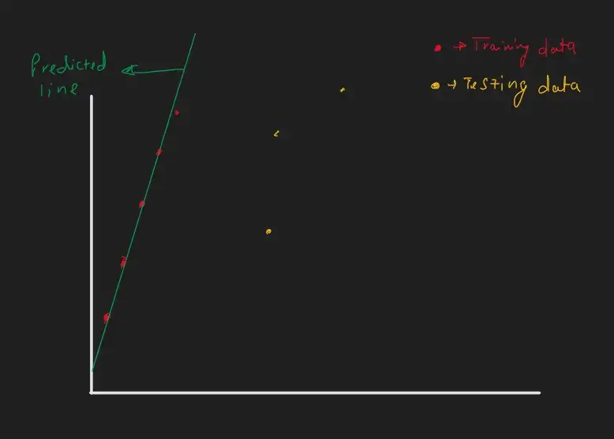
First, we will try to understand the causes of overfitting in the linear regression model.
When the model is going to have too many parameters and model parameters are having high values then it is said to be a complex model.
If the model is complex, it will have high Variance (Sensitivity ), resulting in overfitting.
The line fits perfectly to training data but not too testing data. The model is not generalized. Linear Regression model is having m (slope)value to be high as the slope of the line is high so this result in a high variance model.
In y=mx+c if the m value is higher than the small change in x there is a big change in y. if the slope of the line would have less in that case there would be less overfitting
Regularization will help to reduce m value. so if we succeed in decreasing the m value we can make the model more generalized.

Slide 3
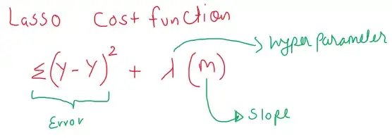
L1: LASSO (Least Absolute Shrinkage Selector Operator)
Lasso Cost Function =Sum of Error + Sum of the absolute value of coefficients.
LASSO Cost function will find a predicted line which is having less m value and also less error. It can also eliminate some features by making the m value zero.

Slide 4
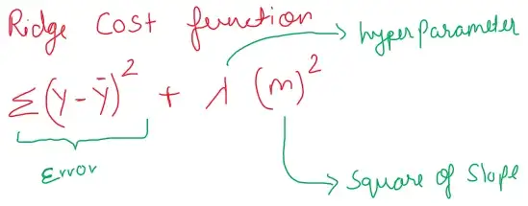
L2: Ridge
Ridge cost function: Sum of Error + Sum of the squares of coefficients
Ridge shrink the parameter it helps in preventing multi collinearity.

Slide 5
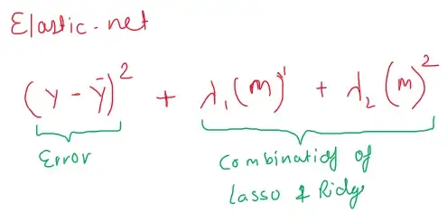
Elastic Net
Elastic net uses the combination of LASSO & Ridge.
Elastic net: Sum of errors + Sum of the absolute value of coefficients + Sum of the squares of coefficients.

Slide 6
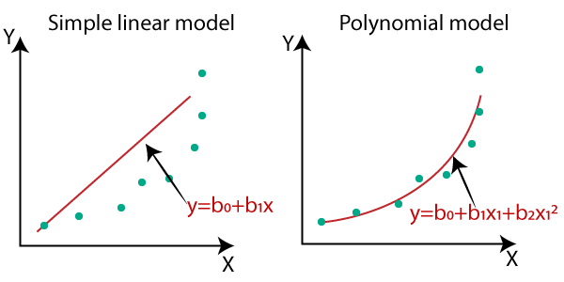
Polynomial Regression

Slide 7
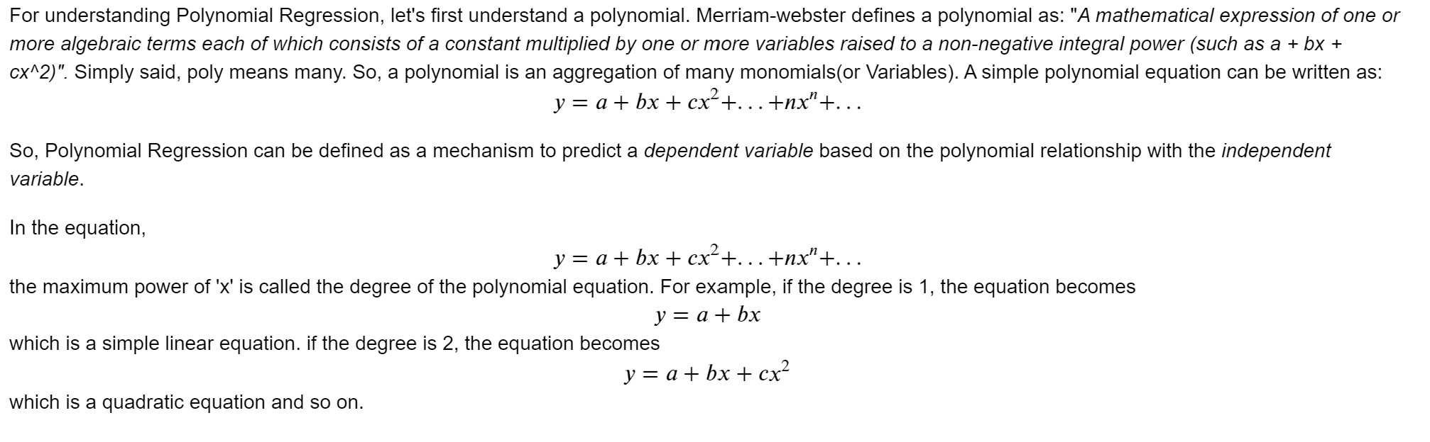
Polynomial Regression

Slide 8
Logistic Regression (Logit Regression)
It is often used for classification and it estimates the probability of an event
for logistic regression, we calculate probability, i.e. y is the probability of a given variable x belonging to a certain class. Thus, it is obvious that the value of y should lie between 0 and
For linear regression, the model is defined by: 𝑦=𝛽0+𝛽1𝑥 - (i)
But, when we use equation(i) to calculate probability, we would get values less than 0 as well as greater than 1. That doesn’t make any sense . So, we need to use such an equation which always gives values between 0 and 1, as we desire while calculating the probability.
We use the sigmoid function as the underlying function in Logistic regression

Slide 9
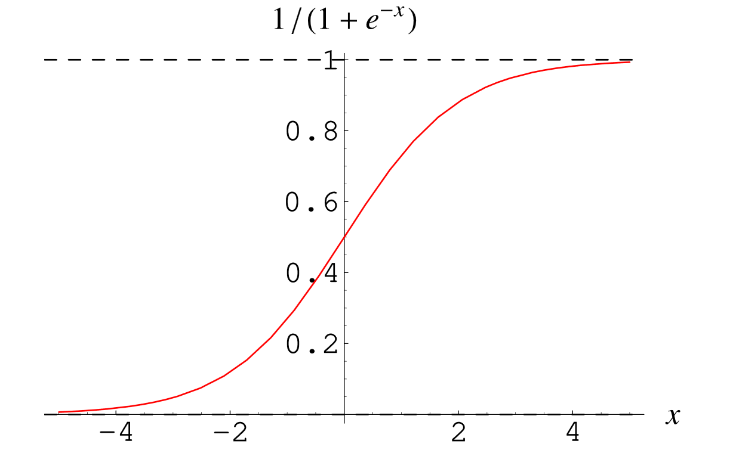
Sigmoid Function
Why do we use the Sigmoid Function?
The sigmoid function’s range is bounded between 0 and 1. Thus it’s useful in calculating the probability for the Logistic function.
It’s derivative is easy to calculate than other functions which is useful during gradient descent calculation.
It is a simple way of introducing non-linearity to the model.

Slide 10
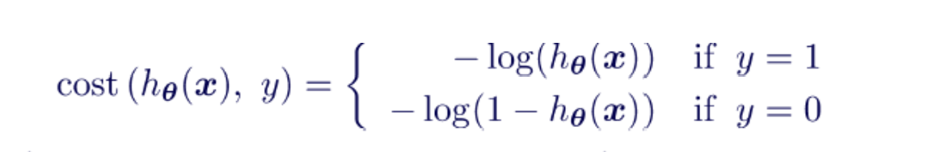
Cost / Loss function
The cost function used in Logistic Regression is Log Loss.

Slide 11
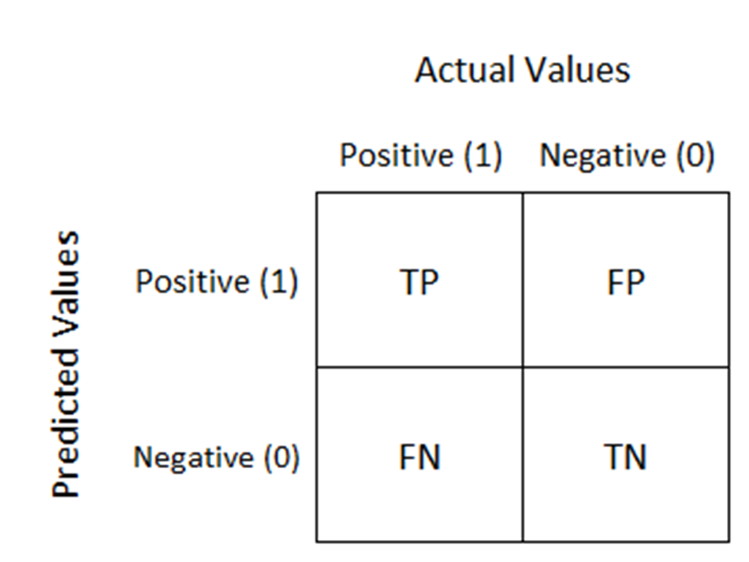
Evaluating Classifier - Confusion Matrix
A confusion matrix is a table that is often used to describe the performance of a classification model (or "classifier") on a set of test data for which the true values are known.

Slide 12
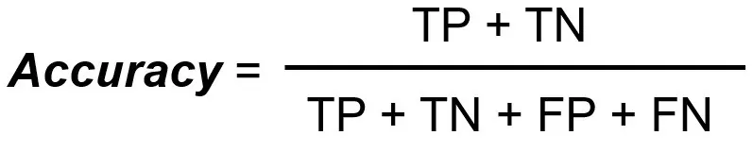
Accuracy

Slide 13
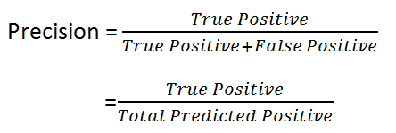
Precision
It is Also called Positive predictive value. The ratio of correct positive predictions to the total predicted positives
How many Positive value classifier correctly classified

Slide 14
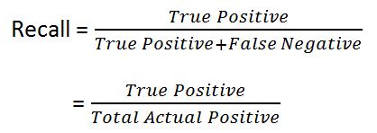
Recall
Recall is defined as the ratio of the total number of correctly classified positive classes divide by the total number of positive classes. Or, out of all the positive classes, how much we have predicted correctly. Recall should be high.

Slide 15
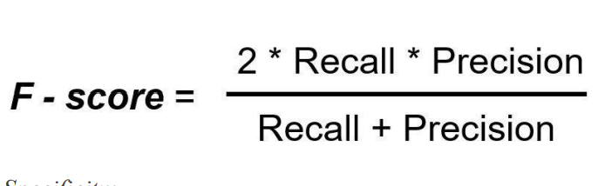
F1 Score
It is difficult to compare two models with different Precision and Recall. So to make them comparable,
we use F-Score. It is the Harmonic Mean of Precision and Recall. As compared to Arithmetic Mean,
Harmonic Mean punishes the extreme values more. F-score should be high.

Slide 16
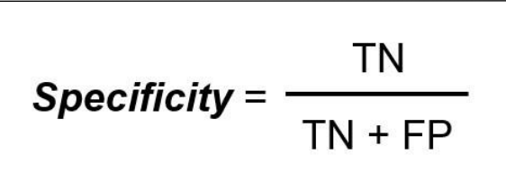
Specificity
Specificity determines the proportion of actual negatives that are correctly identified

Slide 17
Summary
Precision is how certain you are of your true positives. Recall is how certain you are that you are not missing any positives.
Choose Recall if the occurrence of false negatives is unaccepted/intolerable. For example, in the case of diabetes that you would rather have some extra false positives (false alarms) over saving some false negatives.
Choose Precision if you want to be more confident of your true positives. For example, in case of spam emails, you would rather have some spam emails in your inbox rather than some regular emails in your spam box. You would like to be extra sure that email X is spam before we put it in the spam box.
Choose Specificity if you want to cover all true negatives, i.e. meaning we do not want any false alarms or false positives. For example, in case of a drug test in which all people who test positive will immediately go to jail, you would not want anyone drug-free going to jail

Slide 18
ROC AUC
ROC <- Receiver Operating Characteristic curve
AUC <- Area Under the Curve
An ROC curve (receiver operating characteristic curve) is a graph showing the performance of a classification model at all classification thresholds. This curve plots two parameters:
True Positive Rate
False Positive Rate
True Positive Rate (TPR) is a synonym for recall and is therefore defined as follows:
TPR = TP / TP + FN
False Positive Rate (FPR) is defined as follows:
FPR = FP / FP + TN

Slide 19
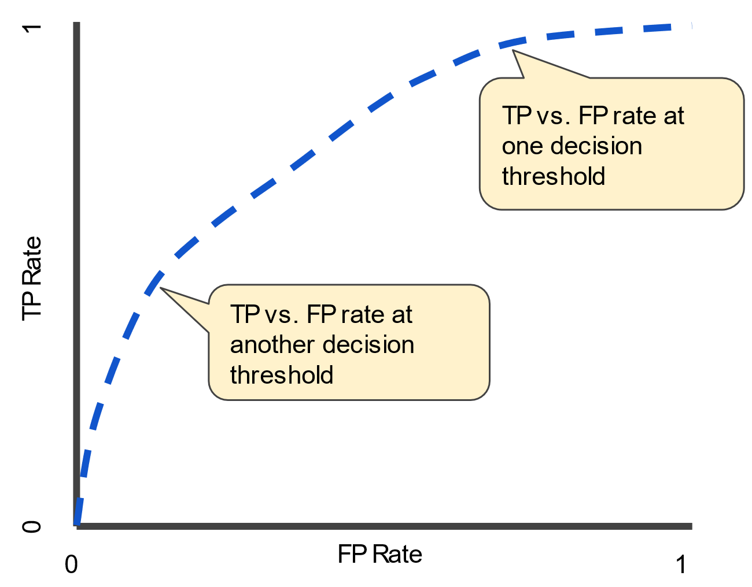

Slide 20
ROC AUC - Summary
AUC - ROC curve is a performance measurement for the classification problems at various threshold settings. ROC is a probability curve and AUC represents the degree or measure of separability. It tells how much the model is capable of distinguishing between classes. Higher the AUC, the better the model is at predicting 0 classes as 0 and 1 classes as 1. By analogy, the Higher the AUC, the better the model is at distinguishing between patients with the disease and no disease.

